Slide 1
Non-Verbal Communication

Slide 2
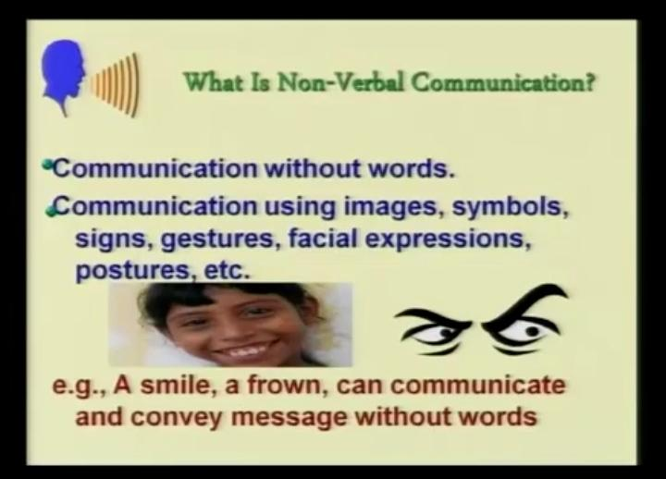
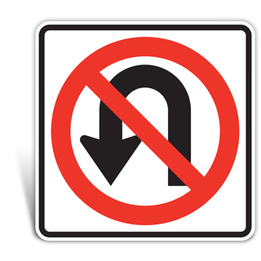
Non-verbal Communication

Slide 3
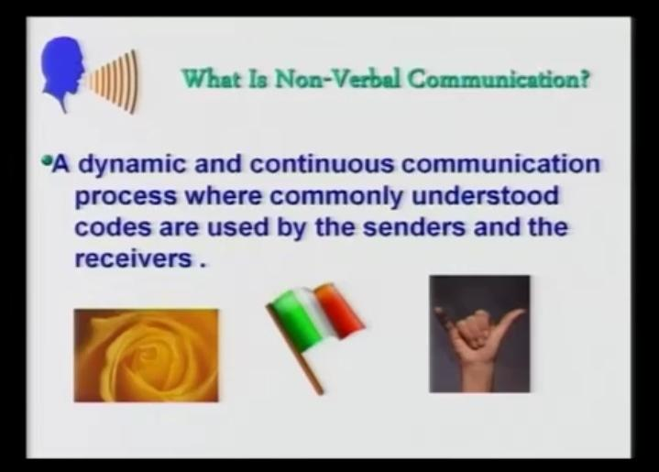

Slide 4
Meaning
Non-verbal com­munication refers to all communication that occurs without the use of words, spoken or written.
Non-verbal cues, however, speak louder than words, as even though speech can be made up, bodily expressions can rarely be masked well enough to hide one’s true feelings and emotions.
It is difficult to analyse them accurately. This is because the interpretation of non-verbal cues is a very subjective concept, varying based on people’s varied backgrounds.

Slide 5
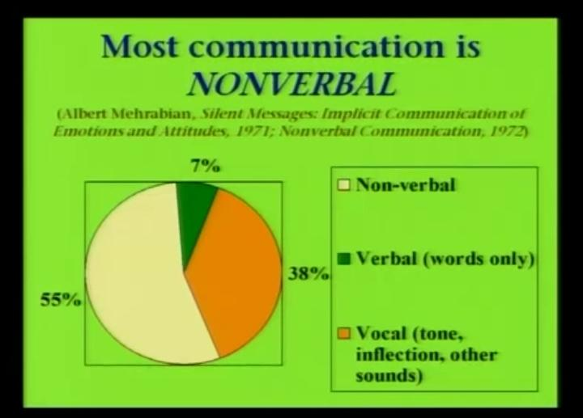

Slide 6
Types/Elements of Non-verbal Communication.
KINESICS
Personal appearance
Posture
Gesture
Facial expression
PROXEMICS
CHRONEMICS
Haptics
Olfactics
Chromatics
Silence
Sign language
Artifacts
Paralanguage

Slide 7
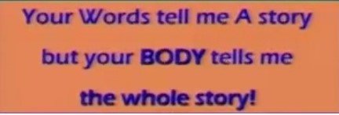
KINESICS
Kinesics is the study of the body’s physical movements. It is the way the body communicates without words, i.e., through the various movements of its parts.
On paper, words remain static; however, punctuation marks are used to convey pauses, expressions, emotions, etc. But in face-to-face communication, the message is conveyed on two levels simultaneously.
For example, suppose you are congratulating two of your friends on their successful interviews. If you extend your hand to them with a big smile on your face along with the utterance, ‘Congrats’, your appreciation has more impact on them than the word in isolation. Your smile and the handshake are kinesics.

Slide 8
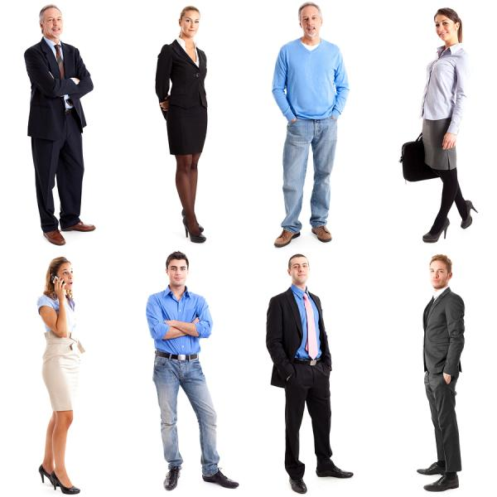
Personal appearance
People see before they hear. Just like we adapt our language to the audience, we should also dress appropriately.
Today, the purpose of clothing has altered from fulﬁlling a basic need to expressing oneself.
Appearance includes clothes, hair, accessories, cosmetics, and so on.

Slide 9
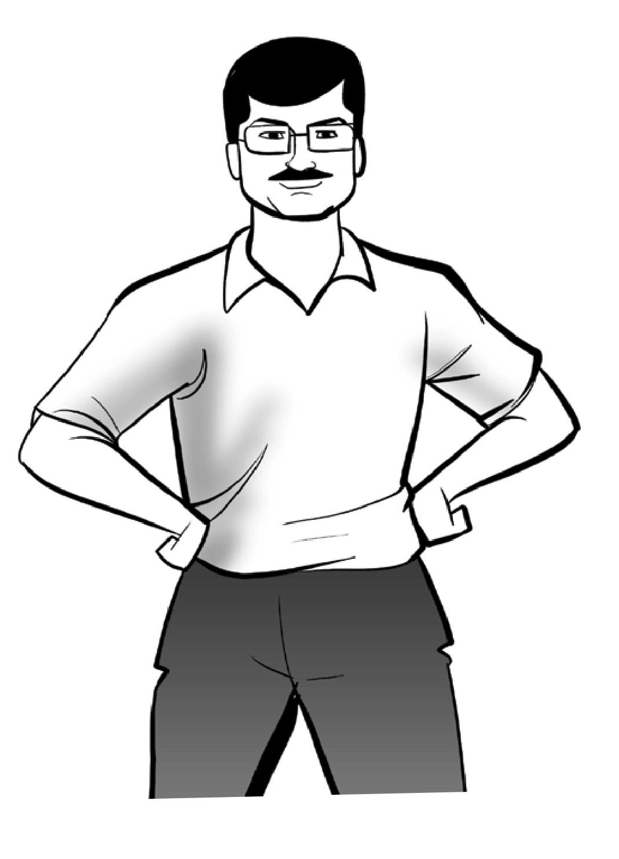
Posture
Posture generally refers to the way we hold ourselves when we stand, sit, or walk.
One’s posture changes according to the situation.
The way one sits, stands, or walks reveals a lot.
For instance, during an oral presentation, stiff positions, such as standing akimbo (with hands on hips and elbows pointing away from the body), send the message of defiance or aggression.

Slide 10
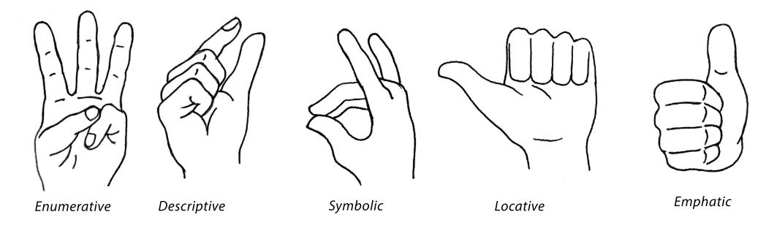
Gesture
Gesture is the movement made by hands, head, or face. Skillful and appropriate gestures can add to the impact of verbal communication.
An awkward gesture (like playing with a key chain or button) can mar the effectiveness of the message.
It has been observed that there are as many as 700,000 varied hand gestures alone (Birdwhistell 1952), and the meanings derived from them may vary from individual to individual.

Slide 11
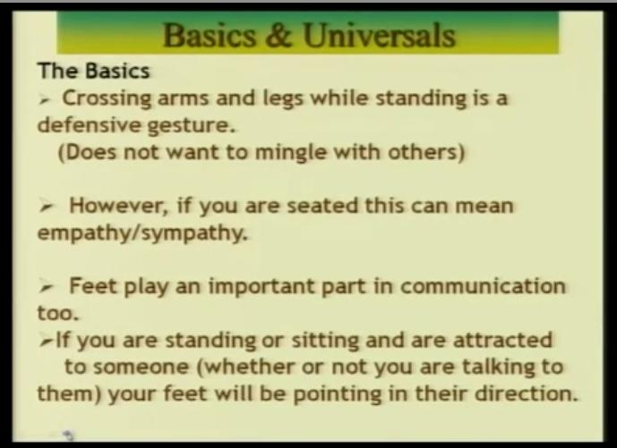

Slide 12
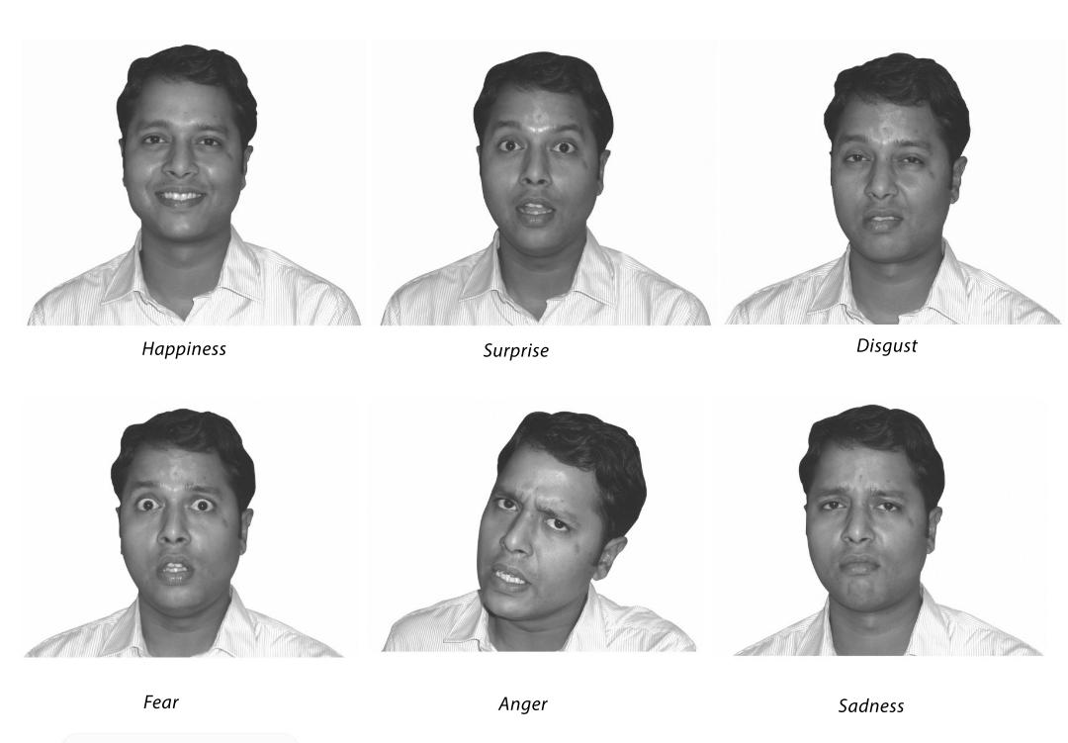
Facial expression
The face is the most expressive part of our body.
A smile stands for friendliness, a frown for discontent, raised eyebrows for disbelief, tightened jaw muscles for antagonism, etc.
People tend to hide their true feelings, and project expressions that are appropriate according to the circumstances.
The six basic facial expressions are:
Happiness
Surprise
Disgust
Fear
Anger
Sadness

Slide 13
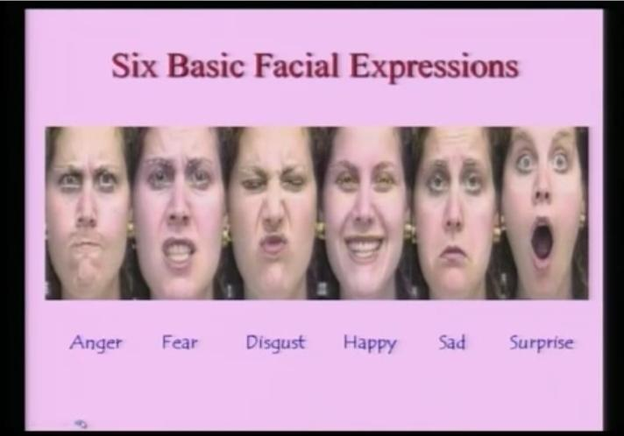

Slide 14
Eye contact (Oculesics)
Eyes are considered to be the windows of the soul.
We look at the eyes of a speaker to find out the truthfulness of his/her words, intelligence, attitudes, and feelings.
Eyes are also a rich source of feedback.
Prolonging the eye contact for three to five seconds (without, however, giving the impression of staring) tells the audience that the presenter is sincere in what he/she says and that he/she wants us to pay attention.

Slide 15
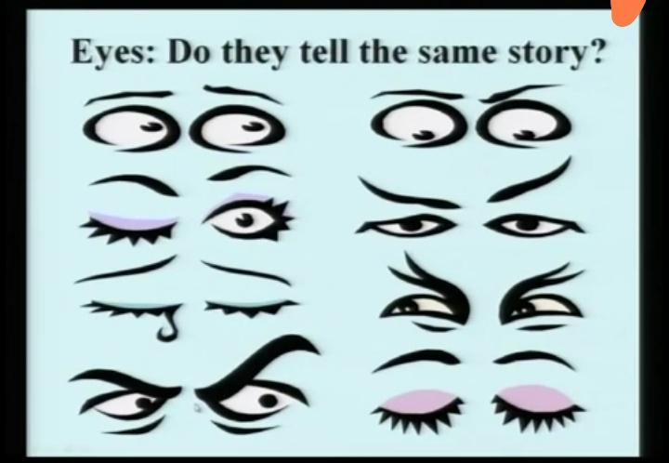

Slide 16
Proxemics (Physical Space)
Proxemics is the study of physical space in interpersonal relations.
In a professional setting, space is used to signal power and status.
Gestures should be in accordance with the space available.
Interestingly, like kinesics, proxemics also has cultural variations.

Slide 17
CHRONEMICS (Time)
Chronemics is the study of how human beings communicate through their use of time.
When we are late for an appointment, people react negatively. If we arrive early, we are considered either over-eager or aggressive. So, we should always be on time.
People have their own time language. To one person who wakes up at 8:00 a.m., 6:30 a.m. may be early.
Time language also varies from culture to culture. In Latin countries, meetings usually begin well after their appointed time.
In India, time language varies according to the occasion. Punctuality is expected for a professional meeting, but it is not insisted upon for a party. People in India are generally liberal with time.

Slide 18
Olfactics (Smell)
The study of sense of smell
Someone’s smell can have a positive or negative effect on the oral message.
Although people of the U.S. respond negatively to body odors, Arabs are comfortable with natural body odors.
Other cultures in which smell plays an important role including the Japanese and Samoans.

Slide 19
Haptics (Touch)
Refers to communicating through the use of bodily contact.
Touch, when used properly, may create feelings of warmth and trust; when used improperly, touch may cause annoyance and betray trust.

Slide 20
Paralanguage
Paralanguage is used to describe a wide range of vocal characteristics which help to express and reflect the speaker’s attitude.
Paralanguage is non-verbal in nature and depends on voice, intonation, pitch, pause, volume, stress, gestures, and signals.
Through these, one’s voice can convey enthusiasm, confidence, anxiety and the speaker’s mental state and temperament.

Slide 21
Chromatics (Colour)
Communication of messages through colors.
It is a scientific movement which explores the physical properties of colour and the effect of color on humans.
The connotations colors have may be positive or negative depending on the culture.
In Us, it’s common to wear black when mourning, in India people prefer white.

Slide 22
Silence
Another important aspect in communication.
When we are silent, we are also communicating! What we communicate depends on what kind of silence it is.
Mostly subject of conversation plays major role in this.
The more emotionally loaded subject is, the more silence we need.
Silence in group conversations are difficult to be handled for lot of people.

Slide 23
Sign language
Visual Sign
Crossed bones under a skull as a danger signal.
Cross over a cigarette as warning against smoking.
Lights-green or red at traffic points, railway stations, outside operation theatre of hospital, revolving light on the top of VIP vehicle/ambulance.
Audio Signs
Alarm signals
Blowing a horn
Buzzer, bells

Slide 24
Clothing & Other Artifacts
Artifacts are forms of decorative ornamentation that are chosen to represent self-concept. They can include rings and tattoos, but may also include brand names and logos.
From clothes to cars, watches, briefcases, purses, and even eyeglasses, what we choose to surround ourselves with communicates something about our sense of self.
They may project gender, role or position, class or status, personality, and group membership or affiliation.

Slide 25
Nonverbal communication ( Video resources)
https://www.youtube.com/watch?v=fLaslONQAKM
https://www.youtube.com/watch?v=4jwUXV4QaTw
https://www.youtube.com/watch?v=W3P3rT0j2gQ

